Slide 1
Obesity Microbiome HPFS data

Slide 2
HPFS data
6 mo
Stool 1, 2
Plasma 1
DDR w1
Stool 3, 4
Plasma 2
DDR w2
FFQ
BMI

Slide 3
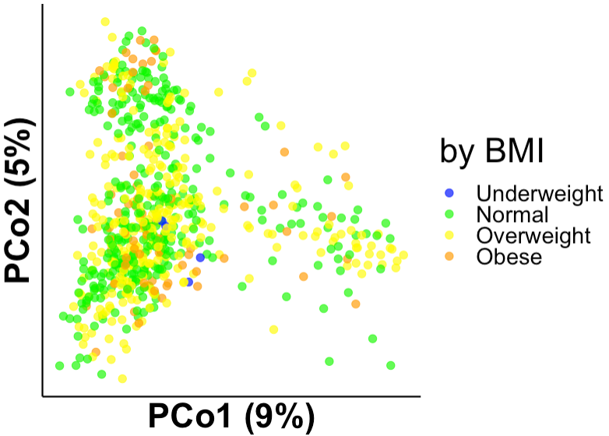
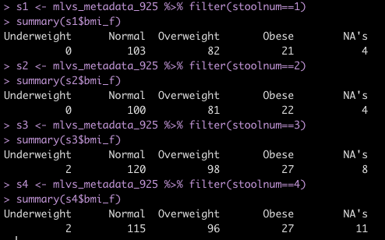
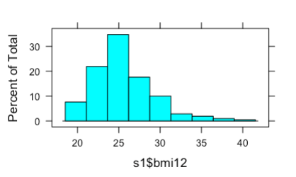
What we have
1st stool
1st stool
PCOA by bray, unsupervised
+ Other lipid metabolite indicators in plasma

Slide 4
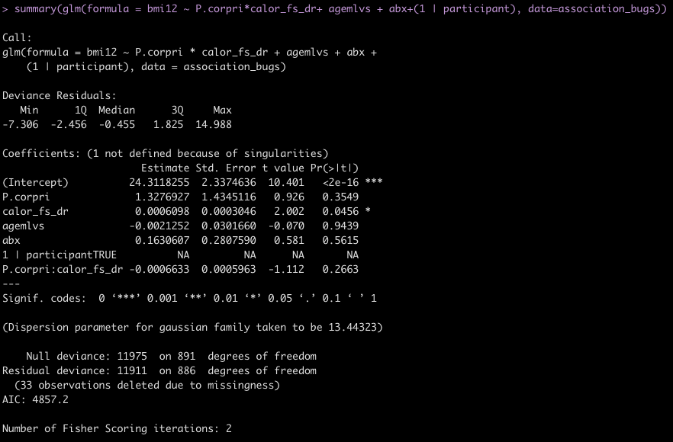
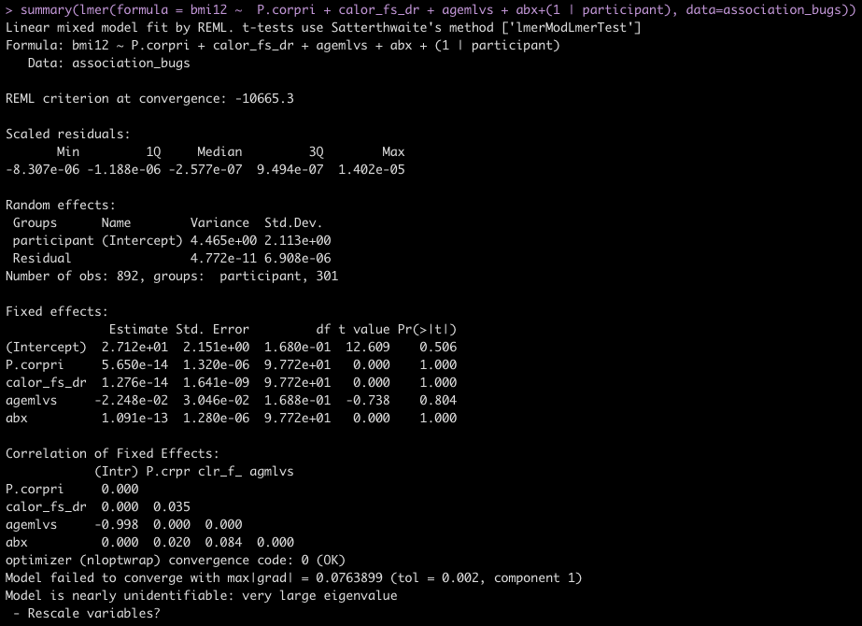
P.corpri
Notes:
Andrew Chan
Omega 3 -> obesity indicators hdl tc

Slide 5
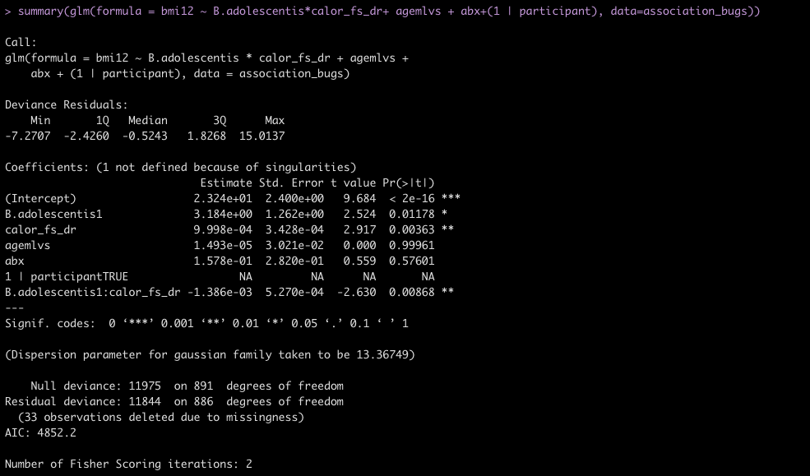
s__Bifidobacterium_adolescentis
Notes:
Mixed model, m

Slide 6
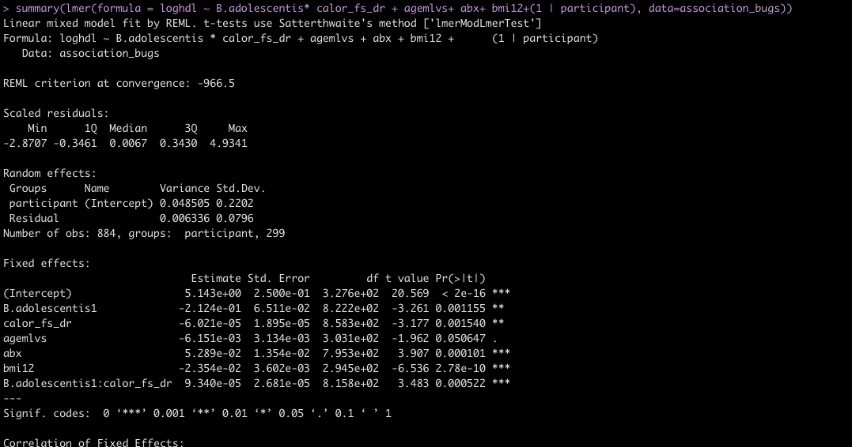
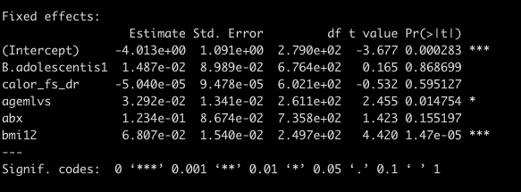
logHDL ~ s__Bifidobacterium_adolescentis
Even associated with hdl

Slide 7
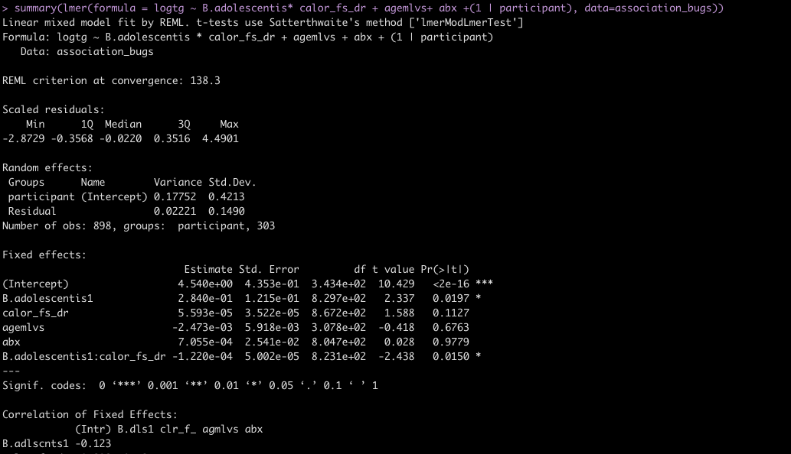
logTG ~ B adolescentis

Slide 8
